Slide 1
Mokum Airways
BA2018
Daphne Molenwijk, Laura Holt, Wouter den Duijn, Joyce Timmer

Slide 2
The Case
6 aircrafts
28 cities
Create one-day flight schedules
20 hour day
Take into account boarding and refuelling times
Profit is the number of passengers times the corresponding kilometres.
Detours

Slide 3
Random Algorithm
Create random route
Add Amsterdam if not start city
Add random city at random index if valid
Add random number of passengers if valid
Stop if no more flying time left
Store the best route

Slide 4
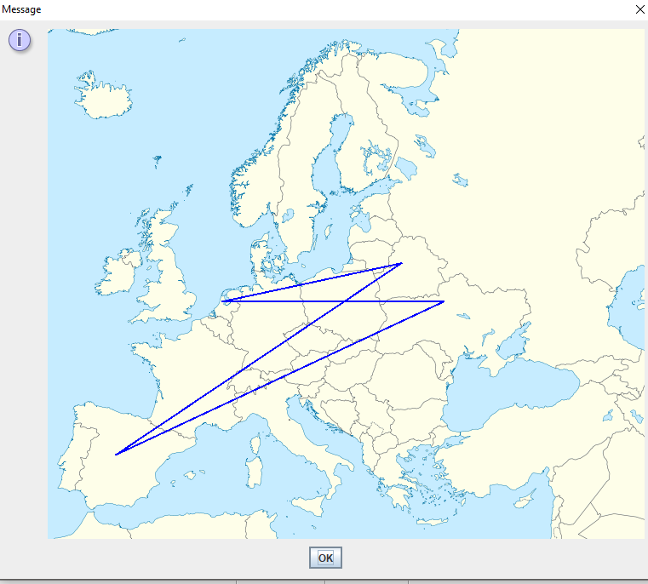
Random Algorithm
Schedule: [Amsterdam, Minsk, Madrid, Kiev, Amsterdam]
Profit: €1,083,111.00

Slide 5
Hill Climber Algorithm
Hill Climber Restart
Start with random route
Apply random mutations
Local optimum → Restart with new random route

Slide 6
Mutations
Add/Remove city
Add/Remove passengers
Swap cities
Swap detour

Slide 7
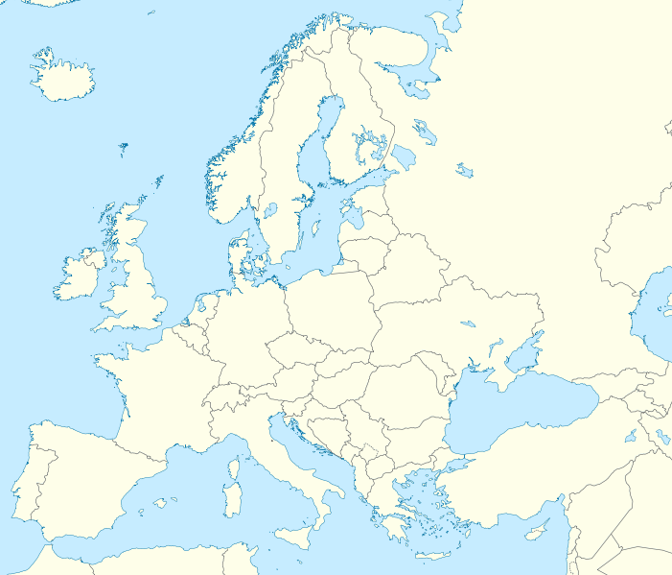
Swap detour
Old:
MAD → ATH 150
MAD → AMS 50
AMS → ATH 50
New:
MAD → ATH 50
MAD → AMS 150
AMS → ATH 150

Slide 8
Current status
Implementing mutations
Implementing hill climber algorithm

